Slide 1
Letter Writing
Letter
Writing
Letter of Enquiry

Slide 2
Learning Outcomes
Analyse and compare various formal letters to note differences of conventions, vocabulary, style and tone.
Follow conventions of formal letter with respect to layout, solutions, etc.
Recognize and demonstrate use of appropriate vocabulary, style and tone in letters of enquiry.
Identify the elements of a letter.
Apply all the elements to compose letter.

Slide 3
Activity
For Discussion:
Have you ever written a letter of enquiry ?
For what purpose letter of enquiry is written?
What kind of enquiries can you make through the letter?
Activity

Slide 4
Format of Letter of Enquiry
Format
Sender’s Address
Date
Receiver’s Address
Subject
Salutation
Body of the Letter
Subscription
Signature
Name (In UPPER CASE)
Enclosed: (Mention enclosed item if any)
Format-
Letter of Enquiry

Slide 5
Elements of Letter of Enquiry
There are 5 elements of letter of enquiry
Heading
Subject
Salutation
Body of the letter
Subscription (Inclusive of enclosed item if any)
5 parts of letter of enquiry

Slide 6
Elements of Letter of Enquiry
Heading
Sender’s Address (2-3 Lines_
Date to be written as M/D/Y (April 23rd 2020)
Receiver’s Address (Including Post if any)
Subject
In UPPER CASE ; not more than 5 words unless mentioned in the question) ENQUIRY REGARDING………………………………..
Salutation
A form of greeting
Written below subject
Written as Dear Sir/Dear Madam
It can be written as Dear Mr Sinha/Dear Dr Sharma

Slide 7
Elements of Letter of Enquiry
Body of the letter
Main part of the letter
Should be precise & brief
Simple and direct language to be used
3 Paras
Para 1-(Mention topic of enquiry, from where did you find about it)
Para 2 (Mention enquiry related to duration, batch, course fee , transportation , faculty)
Para 3 (Request for brochure, information to be sent in self addressed envelope sent by you, early response will be appreciated)
Subscription
To written as Yours sincerely/Yours truly (without apostrophe s in Yours)
Signature of the writer of the letter
NAME in Uppercase and in bracket
Contact/Mobile No.
Also mentioned enclosed item (if any)

Slide 8
Let’s Recap….
Format
Sender’s Address
Date
Receiver’s Address
Subject
Salutation
Body of the Letter
Subscription
Signature
Name ( In UPPER CASE)
Enclosed(Mention enclosed item if any)
Format-
Letter of Enquiry

Slide 9
Just Remember…
Letter of complaint should be
Concise
Authoritative
Constructive
Should have proper format
Word limit: 100-120 words
Just Remember...
Marking Scheme:
M.M.—8
Format-1
Content-4
Expression -3
(Including Fluency & Accuracy)

Slide 10
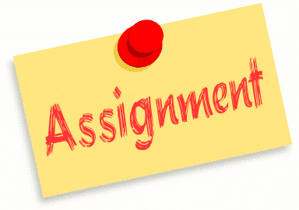
Assignment
Your brother Randhir wishes to join personalty development course after his grade XII exams. Write a letter to ‘Personna’ Personality Centre enquiring about their terms and conditions. You are Sukankya staying at H.No. 63, Sector 15, Mayur Vihar, Delhi.

Slide 11
Next class……
LETTER OF PLACING ORDER

