Slide 1
PARTS OF A COMPUTER
PARTS OF A COMPUTER
GRADE - III
CH - 1

Slide 2
Introduction/PKA
There are many parts that work together to make a computer work.

Slide 3
Learning Outcomes
SWAT –
learn that computer has many parts.
Differentiate between Hardware and software.
Learn various parts of computer and their characteristics.
learn the various keys and their functions of a keyboard.

Slide 4
Parts of a Computer

Slide 5
Parts of a Computer

Slide 6
Parts of a Computer

Slide 7
Parts of a Computer
Hardware : The Physical parts of the computer that you can see, touch or repair.

Slide 8
Parts of a Computer
Software : Software are the programs that give your system instructions.

Slide 9
Parts of a Computer

Slide 10
Parts of a Computer

Slide 11
Parts of a Computer

Slide 12
Parts of a Computer

Slide 13
Parts of a Computer

Slide 14
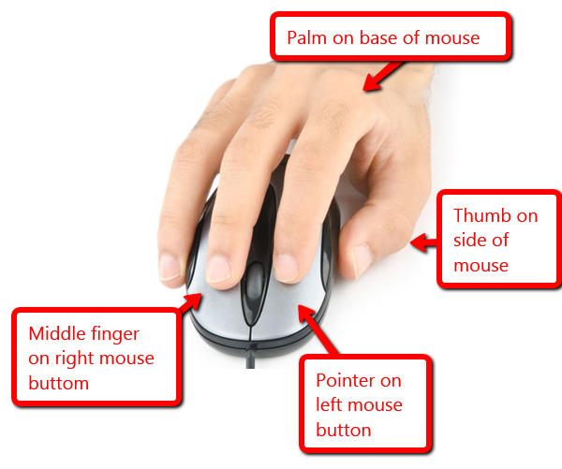
Parts of a Mouse

Slide 15
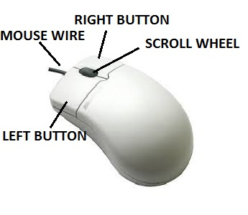
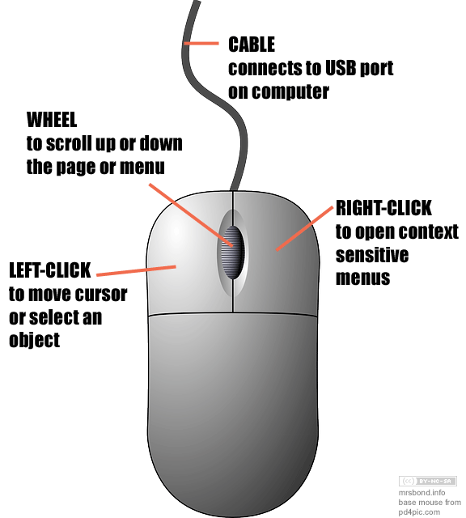
Parts of a Mouse

Slide 16
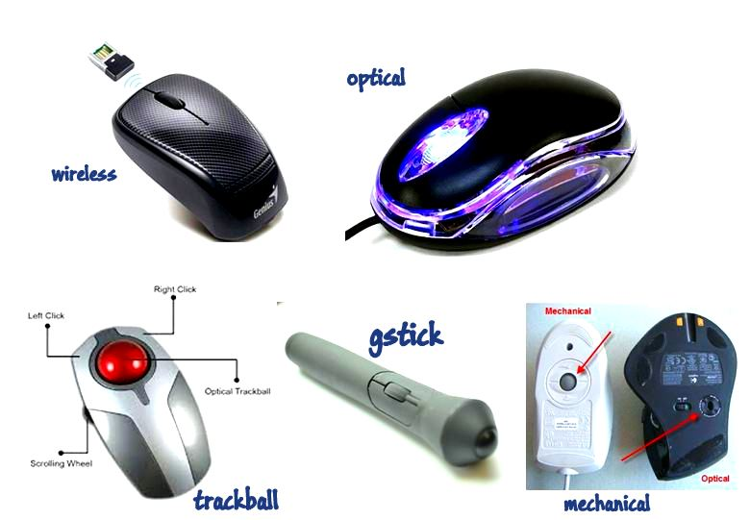
Types of Computer Mouse

Slide 17
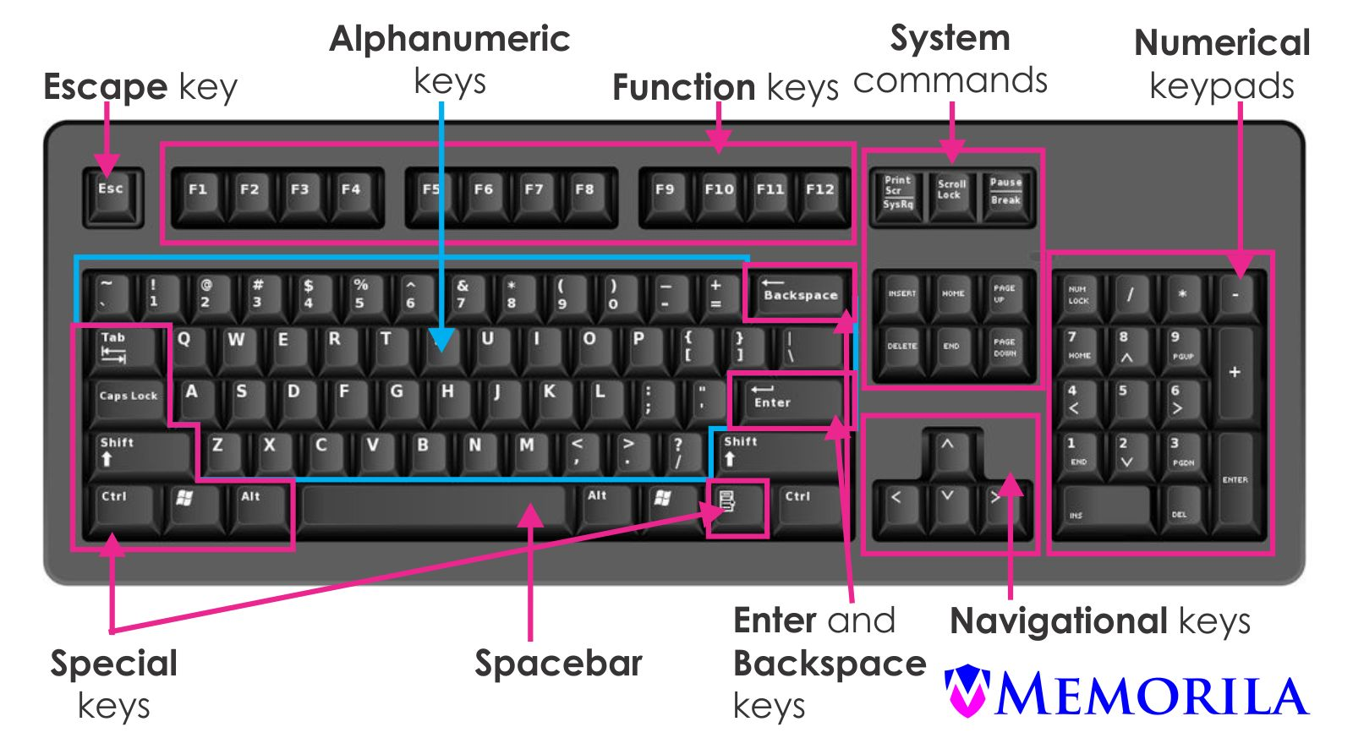
Parts of a Computer

Slide 18
Parts of a Computer

Slide 19
Parts of a Computer

Slide 20
Parts of a Computer

Slide 21
Parts of a Computer

Slide 22
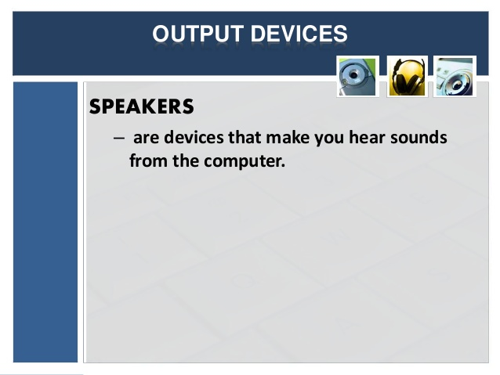
Parts of a Computer

Slide 23
Parts of a Computer

Slide 24
Parts of a Computer

Slide 25
Parts of a Computer

Slide 26
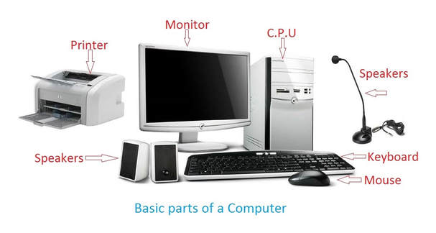
Parts of a Computer

Slide 27
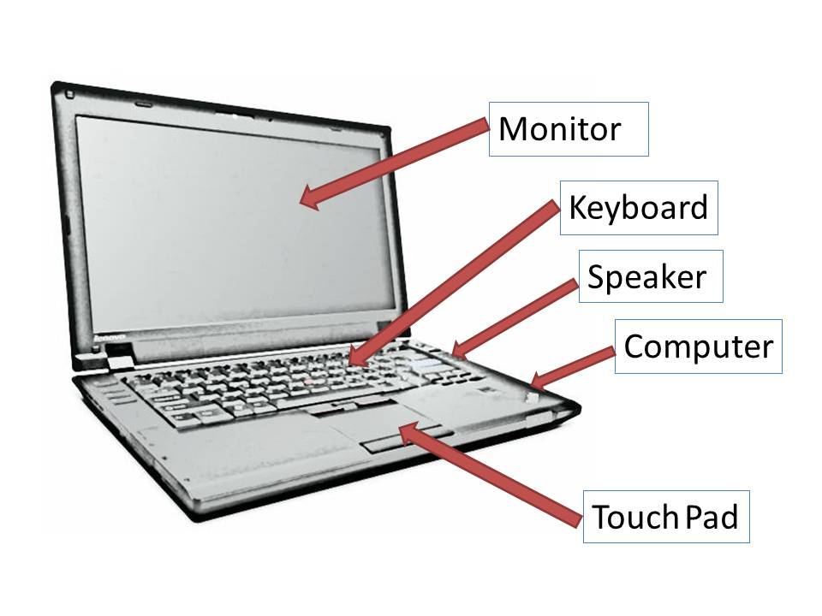
Parts of a Laptop

Slide 28
Differentiation
LA- Name the places where do you see the computer.
MA-What does Input and Output mean?
HA- how many keys are there on a keyboard?

Slide 29
Plenary/Recap
Computer is an electronic device used to input data, process it and provide output.
There are various types of devices.
There are Input, Processing, Output and storage devices.
Function of each key of a keyboard.

Slide 30
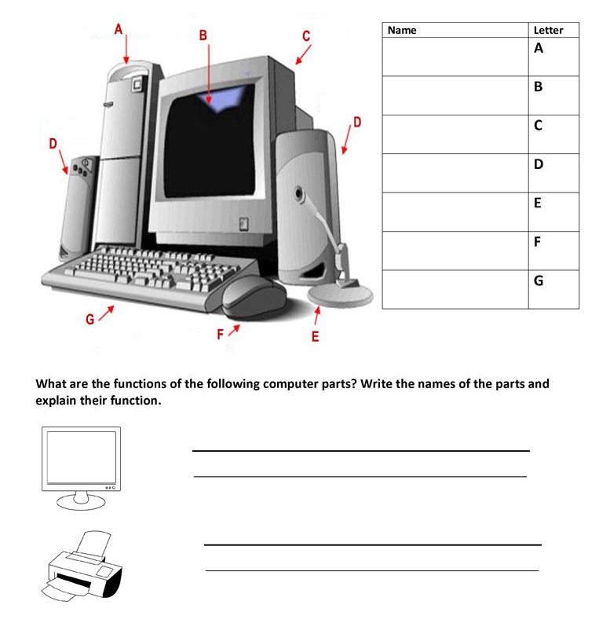
Parts of a Computer

Slide 31
Assignment
Draw and label various parts of a computer.
Type few lines about yourself.

